Slide 1

TEAL COW DAIRY
Ella Wang and Sophie Ivanovic

Slide 2

COMMUNCIATION 11

Slide 3
OVERVIEW
In the initial communication from Teal Cow Dairy, we were asked to determine a weekly feeding strategy over the course of 52 weeks which would earn Teal Cow Dairy the greatest profit.
This problem was a deterministic dynamic programming problem and thus, an exact optimal feeding strategy could be devised. An overview of the problem is as follows:
Cows in the herd
Weekly required feed
Limit on extra energy
The herd is comprised of 4 cows
The herd requires a minimum amount of feed units each week to remain healthy
Each cow in the herd can convert a maximum of 10 units of energy into milk

Slide 4

OPTIMAL SOLUTION
Considering the constraints of the problem, the maximum profit after 52 weeks is $6946.80.
A breakdown of the amount of feed which should be given to the herd each week to achieve this optimal profit is given in the following slides.
6946.80

Slide 5
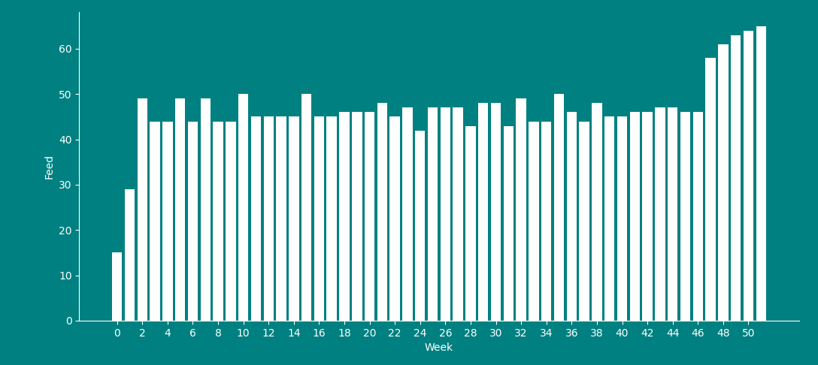
OPTIMAL SOLUTION – TOTAL WEEKLY FEED

Slide 6
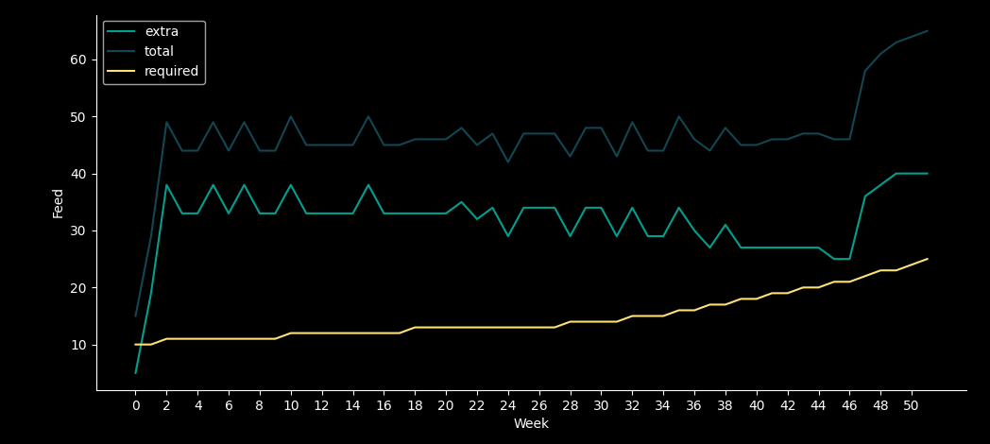
OPTIMAL SOLUTION – FEED BREAKDOWN
The units of feed which achieve the optimal profit are given below:

Slide 7
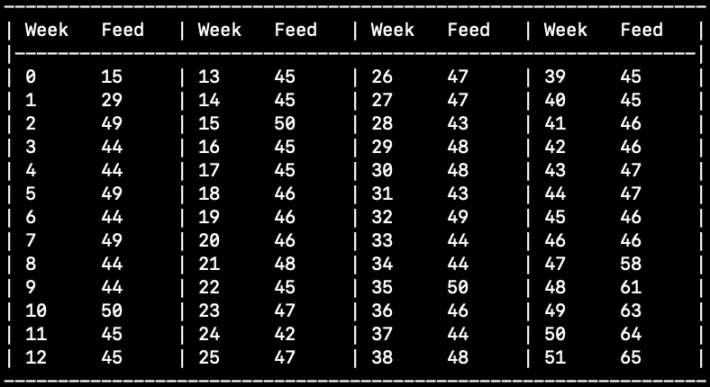
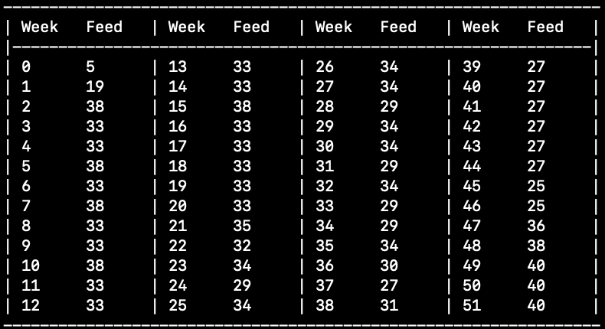
OPTIMAL SOLUTION
The units of feed which achieve the optimal profit are given below:
Total Weekly Feed
Extra Weekly Feed for Profit

Slide 8

COMMUNICATION 12

Slide 9
OVERVIEW
The second communication we received introduced a constraint designed to prevent the field from being baren at the conclusion of the season. Specifically, for every unit of grass below 150 units at the end of the season, a penalty of $5 is incurred.
This added penalty cost will decrease overall profit in the short term but prove beneficial for profit in following years.
The revised optimal profit taking this constraint into account is:
6560.40

Slide 10
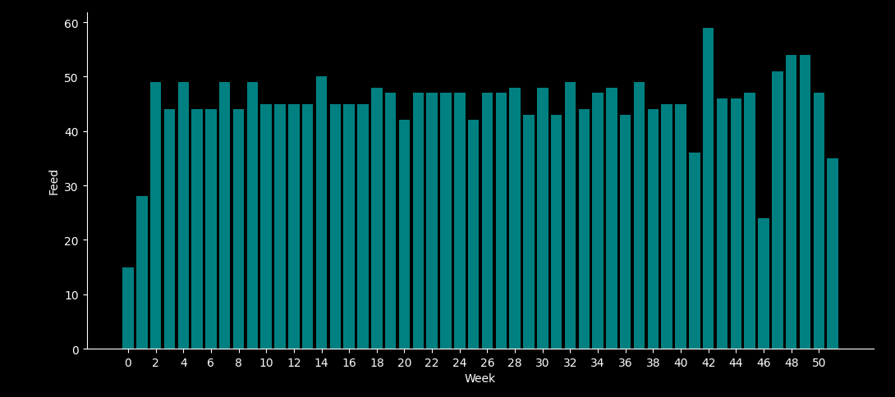
OPTIMAL SOLUTION – TOTAL WEEKLY FEED

Slide 11
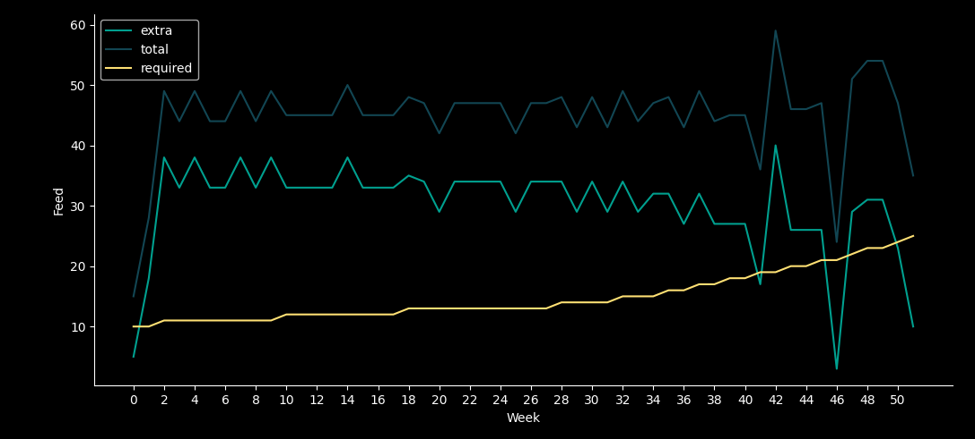
OPTIMAL SOLUTION – FEED BREAKDOWN
The units of feed which achieve the optimal profit are given below:

Slide 12
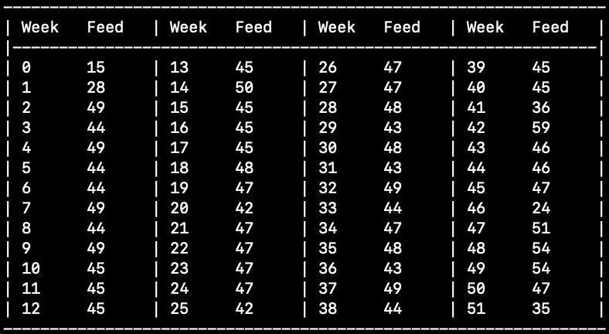
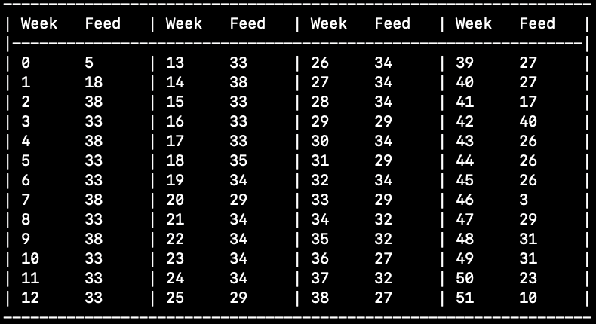
OPTIMAL SOLUTION
The units of feed which achieve the optimal profit are given below:
Total Weekly Feed
Extra Weekly Feed for Profit

Slide 13



OBSERVATIONS
There is a decrease in the weekly feed amount in the final weeks is evident.
This is unsurprising as it would be beneficial to minimise the penalty incurred.
Overall profit after 52 weeks decreased by
In week 46, there is a sharp drop in feed for the herd – only meeting the required feed by 3 units.
$386.40
This correlates to a decrease of 92 extra units of feed in the 52 weeks.

Slide 14
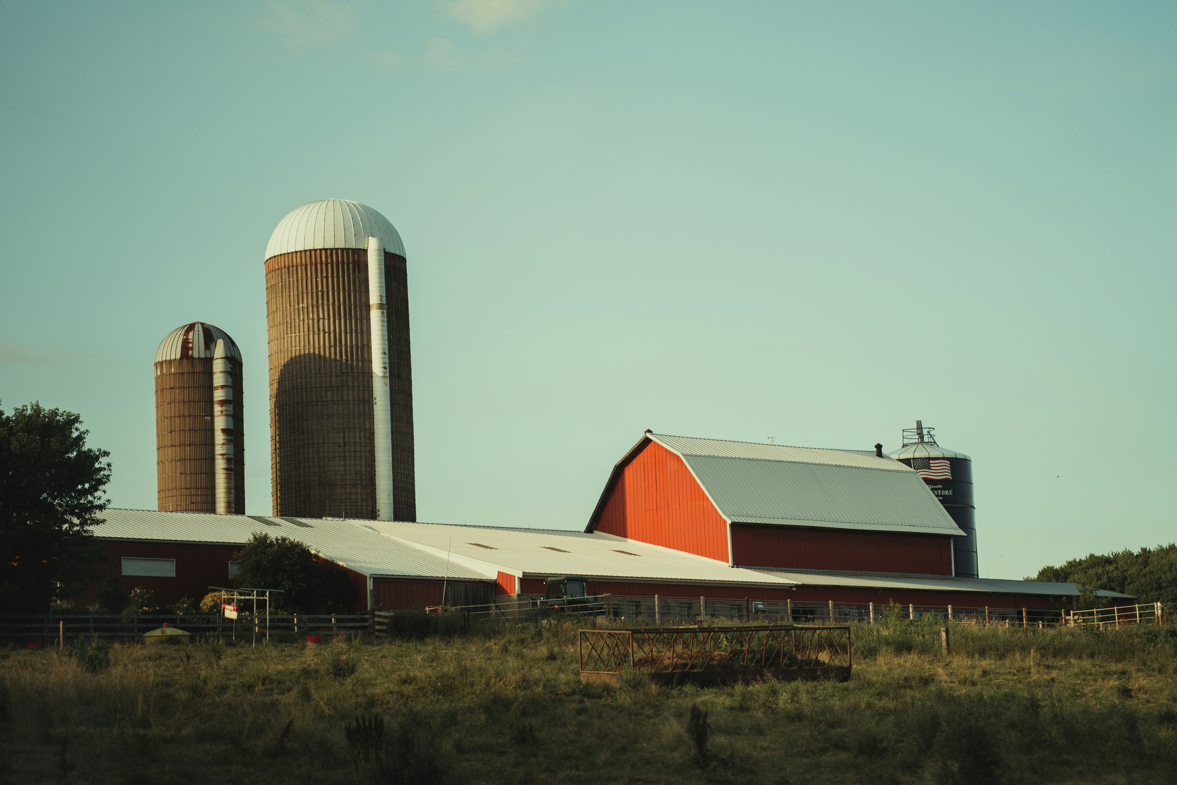
COMMUNICATION 13

Slide 15
OVERVIEW
To improve the applicability of the model to a real-life scenario, the growth model of the grass was refined to account for changes in weather.
For simplicity, it was assumed weather would be good 50% of the time and poor the other 50%.
The mathematical model was revised to incorporate this updated function and the new optimal income was determined to be:
6502.80

Slide 16
OPTIMAL STRATEGY
Unlike the previous communications, with the addition of the consideration for changing weather and this impact on the pasture each week, the problem is no longer deterministic.
Thus, we proceed by describing an optimal strategy, rather than an exact formulation for achieving a maximal profit.
To begin, we determine the units of grass required at the beginning of each week such that the maximum units of extra feed – 10 units per cow in the herd – can be given to the herd. This is considered an indicator of the optimal strategy since extra units are the source of profit for the dairy and would be maximized in an optimal solution.

Slide 17
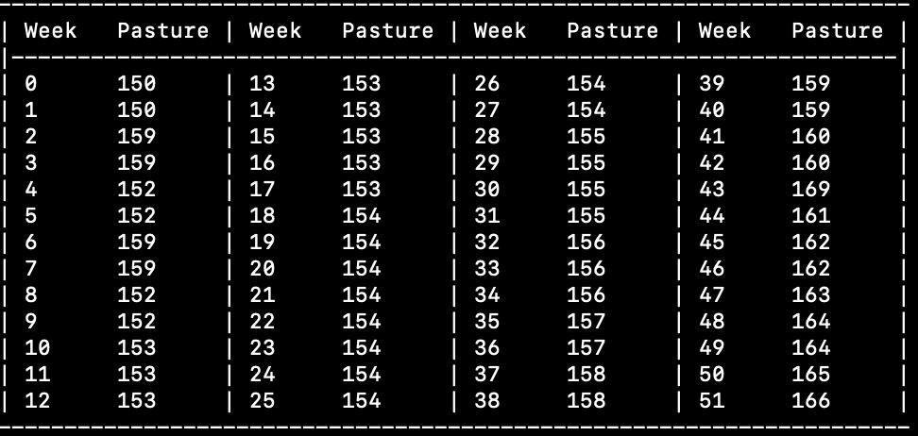
OPTIMAL STRATEGY
The units of feed which achieve the optimal profit – $8736.0 – are given below:

Slide 18
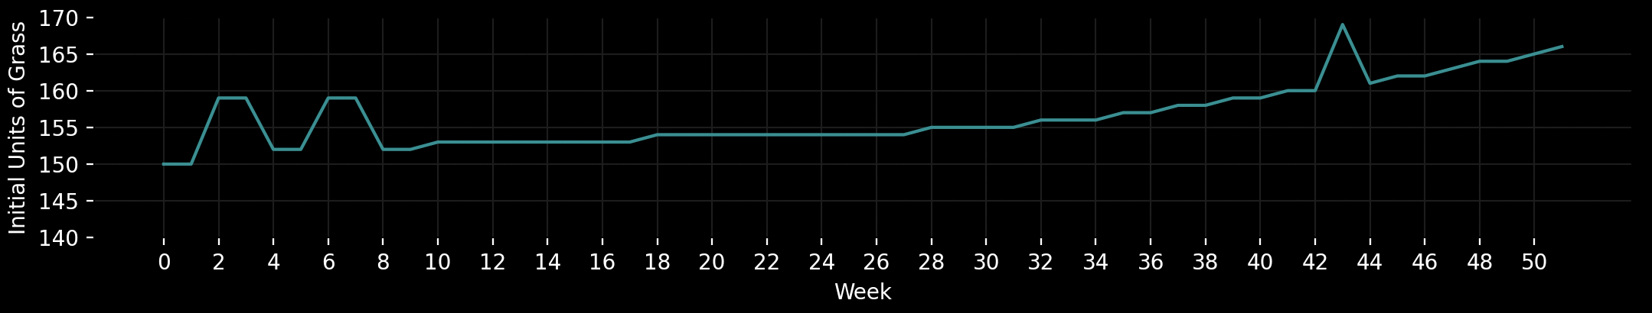
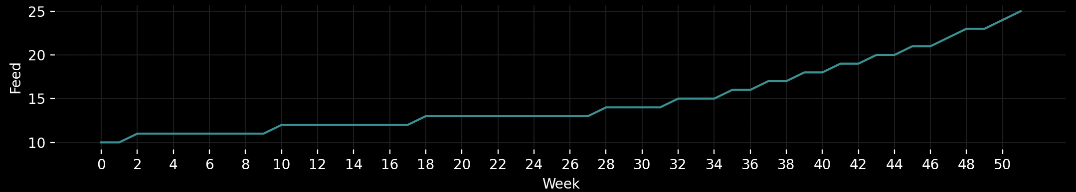
OPTIMAL STRATEGY – REQURIED UNITS OF GRASS
Required Initial Grass Units to Enable Maximum (40) Units of Extra Feed
Required Weekly Feed

Slide 19
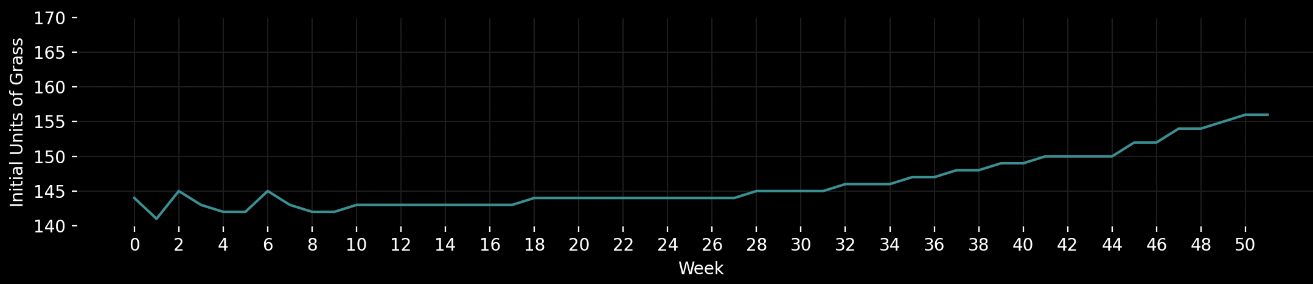
OPTIMAL STRATEGY – REQURIED UNITS OF GRASS
Required Initial Grass Units to Enable >30 Units of Extra Feed
Required Weekly Feed

Slide 20

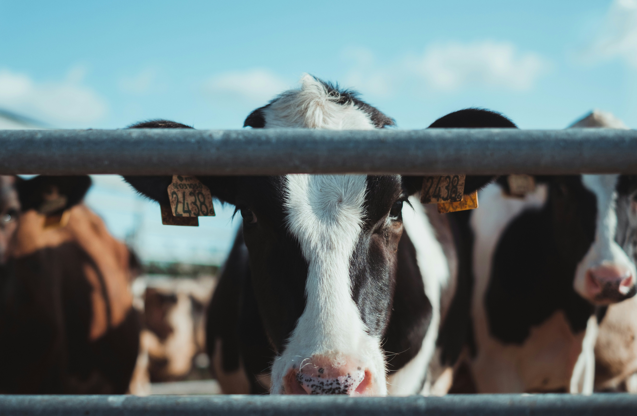
COMMUNICATION 14
Notes:
The fourteenth communication introduces a new action that needs to be decided each week.

Slide 21
OVERVIEW
In your fourteenth communication, you introduced the prospect of drying off cows and stopping lactation for the remainder of the season. This has multiple effects:
Notes:
Now, we can choose to dry off cows, meaning their lactation is stopped for the remainder of the season. This has two affects:
This has two affects:

Slide 22


OVERVIEW
In your fourteenth communication, you introduced the prospect of drying off cows and stopping lactation for the remainder of the season. This has multiple effects:
Advantage
Disadvantage
The weekly required feed is reduced by three units for each dry cow in the herd.
Dry cows cannot be used to produce milk to sell for profit.
Notes:
the required weekly feed is reduced by three units for each dry cow but,
dry cows cannot produce milk and so no profit can be gained from them.

Slide 23
OVERVIEW
In your fourteenth communication, you introduced the prospect of drying off cows and stopping lactation for the remainder of the season. This has multiple effects:
Advantage
Disadvantage
The weekly required feed is reduced by three units for each dry cow in the herd.
Dry cows cannot be used to produce milk to sell for profit.
With this added variable for consideration, the optimal profit after the 52 weeks increases to:
6772.40
Notes:
With this added variable, the expected optimal profit after a year becomes $6772.40.

Slide 24
OPTIMAL STRATEGY
Similarly to the previous communication, we aim to determine an optimal strategy for Teal Cow Dairy.
Again, since profit is determined by the number of extra units of feed given to the herd, we have determined the required units of grass available at the beginning of each week such that 10 units of extra feed are given to each non-dry cow.
Results are given in the following slide.
Notes:
Again, we assume that the optimal strategy can be informed by the required initial units such that the maximum number of extra units of feed can be given.

Slide 25
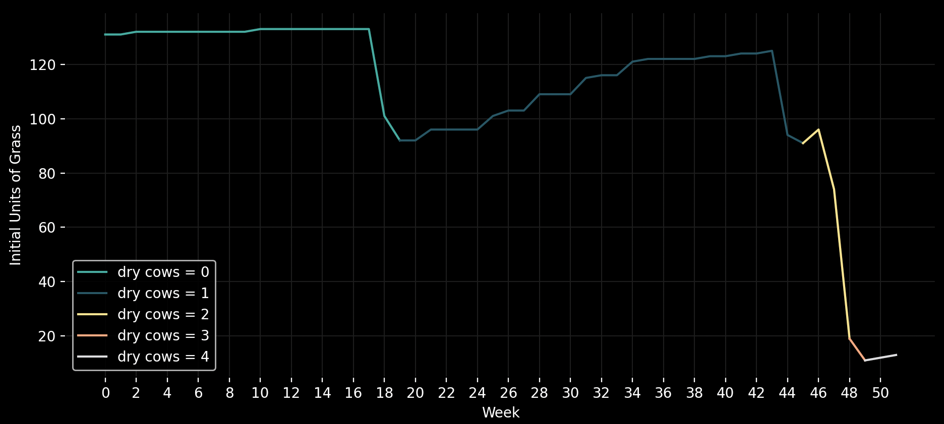
OPTIMAL STRATEGY – INITIAL UNITS OF GRASS FOR MAXIMUM PROFIT
Required Weekly Feed
Notes:
The graph depicts these required initial units of grass. As shown, in the optimal strategy, for the first 18 weeks, it is not in your interests to dry any cows.
In these weeks, 40 extra units of grass can be given to the herd since the whole herd is lactating.
Following this, the strategy suggests cows should be dried in weeks 19, 45, 48 and 49.
As depicted, drying cows corresponds to generally lower initial units of grass since it reduces the maximum number of extra units that can be given.

Slide 26
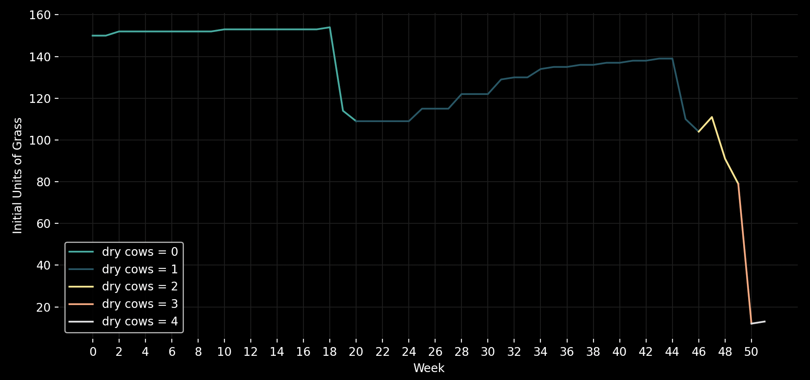
OPTIMAL STRATEGY – INITIAL UNITS OF GRASS FOR MAXIMUM PROFIT
Required Weekly Feed
Notes:
In the case that these requirements cannot be met, to ensure that at least 5 extra units of feed per lactating cow are given to the herd each week, the strategy is as shown.
The general trend is similar to the previous strategy which reinforces that cows should be dried around weeks 19, 45, 48 and 49 to achieve an optimal profit.

Slide 27
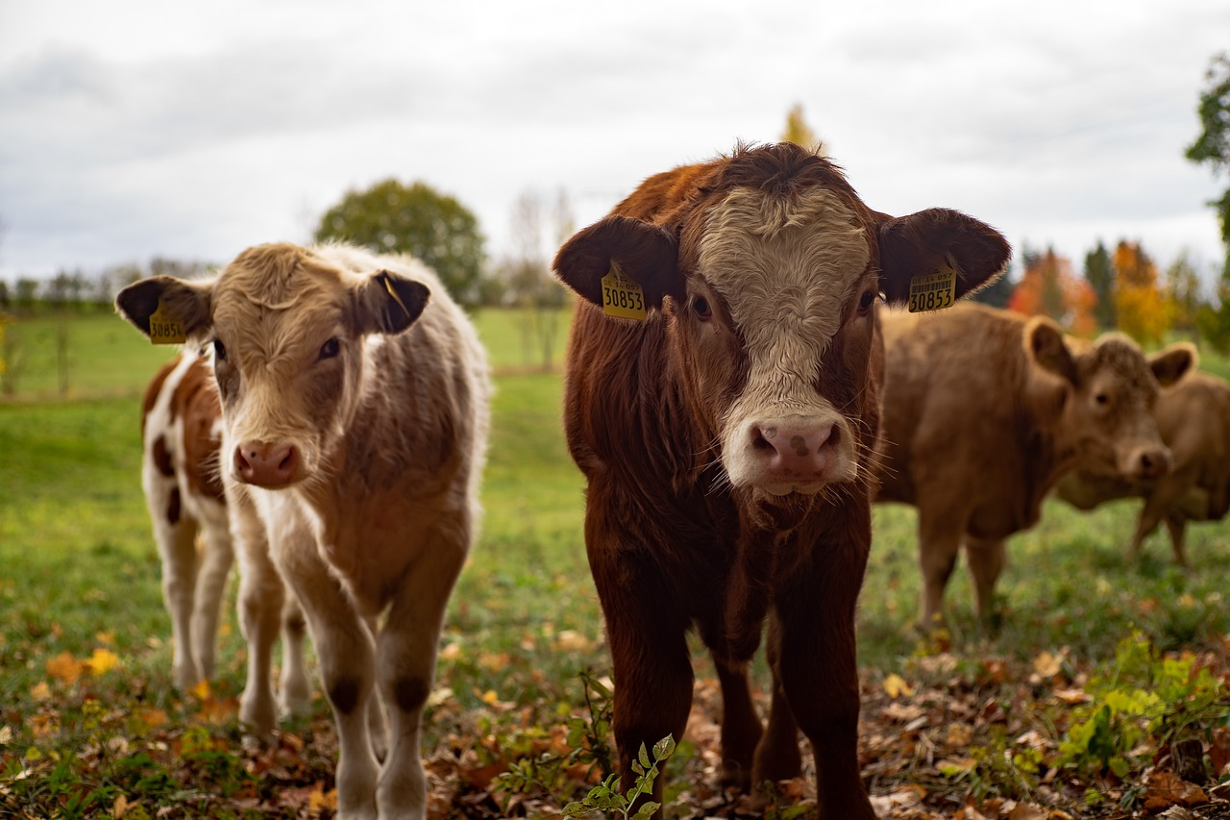
COMMUNICATION 15

Slide 28
OVERVIEW
The final adjustment to the context of the problem is a consideration for the differences between the four members of the herd. Factors such as age, weight, health, etc., can affect the lactation of cows and hence, must be considered when determining optimal feed for the herd and when to dry each cow.
Notes:
The final adjustment to the context of the problem is a consideration for the individual differences among members of the herd, when determining the required units of feed each week.

Slide 29
OVERVIEW
The final adjustment to the context of the problem is a consideration for the differences between the four members of the herd. Factors such as age, weight, health, etc., can affect the lactation of cows and hence, must be considered when determining optimal feed for the herd and when to dry each cow.
With this adjustment, the overall constraints needing to be considered are:
Which cows in the herd have been dried.
Starting units of grass.
The weather conditions each week.
Required units of grass to sustain each cow in the herd.
Notes:
With this adjustment, the overall problem involves many constraints as shown.

Slide 30
OPTIMAL PROFIT
The final optimal profit taking into consideration all constraints of the problem is:
6790.46
In the following slides, we will discuss the strategies that can be employed to achieve this profit.
Notes:
The final optimal profit considering all constraints is $6790.46.

Slide 31
OPTIMAL STRATEGY
 | Base | Inc (t<18) | Inc (t≥18) (quadratic)
Lily | 2.444 | 0.0311 | 0.00251
Betty | 2.454 | 0.0376 | 0.00255
Clover | 2.715 | 0.0283 | 0.00318
Rosie | 2.628 | 0.033 | 0.00297
Notes:
A bit of intuition behind the strategy, also showing how the model would benefit you
Look at the data, we would want to dry Clover or Rosie first, due to their high base, followed by Betty and Lily

Slide 32

OPTIMAL STRATEGY
ROSIE
 | Base | Inc (t<18) | Inc (t≥18) (quadratic)
Lily | 2.444 | 0.0311 | 0.00251
Betty | 2.454 | 0.0376 | 0.00255
Clover | 2.715 | 0.0283 | 0.00318
Rosie | 2.628 | 0.033 | 0.00297
CLOVER
BETTY
LILY
Notes:
Let's assume the order is like this.
But you're not sure when to dry them or whether to dry them at all.

Slide 33
OPTIMAL STRATEGY
ROSIE
WEEK 18?
 | Base | Inc (t<18) | Inc (t≥18) (quadratic)
Lily | 2.444 | 0.0311 | 0.00251
Betty | 2.454 | 0.0376 | 0.00255
Clover | 2.715 | 0.0283 | 0.00318
Rosie | 2.628 | 0.033 | 0.00297
CLOVER
BETTY
LILY
Notes:
Maybe start drying wk18? Since required grass would increment quadratically afterwards.
The point is, without the guide of our model, you might dry the cow too early or too late, and easily miss the maximum profit.

Slide 34
OPTIMAL STRATEGY
ROSIE
We first determine the threshold for grass required at the beginning of each week to ensure that the maximum amount of extra feed can be given to the herd and converted to milk for profit.
CLOVER
BETTY
LILY
Notes:
Again, we find the required initial units of grass such that the maximum number of extra units can be given.

Slide 35
OPTIMAL STRATEGY
ROSIE
WEEK 18
We first determine the threshold for grass required at the beginning of each week to ensure that the maximum amount of extra feed can be given to the herd and converted to milk for profit.
This model reveals that cows in the herd should be dried in the order shown at these weeks.
CLOVER
WEEK 45
BETTY
WEEK 48
LILY
WEEK 49
Notes:
The model suggests that Rosie should be dried first in week 18, followed by Clover in week 45, Betty in week 48 and finally Lily in week 49. Overall, it is clear that most cows should be dried closer to the end of the year to ensure that profit can be maximised throughout the year and required feed is minimised at the end of the year when penalties are incurred.

Slide 36
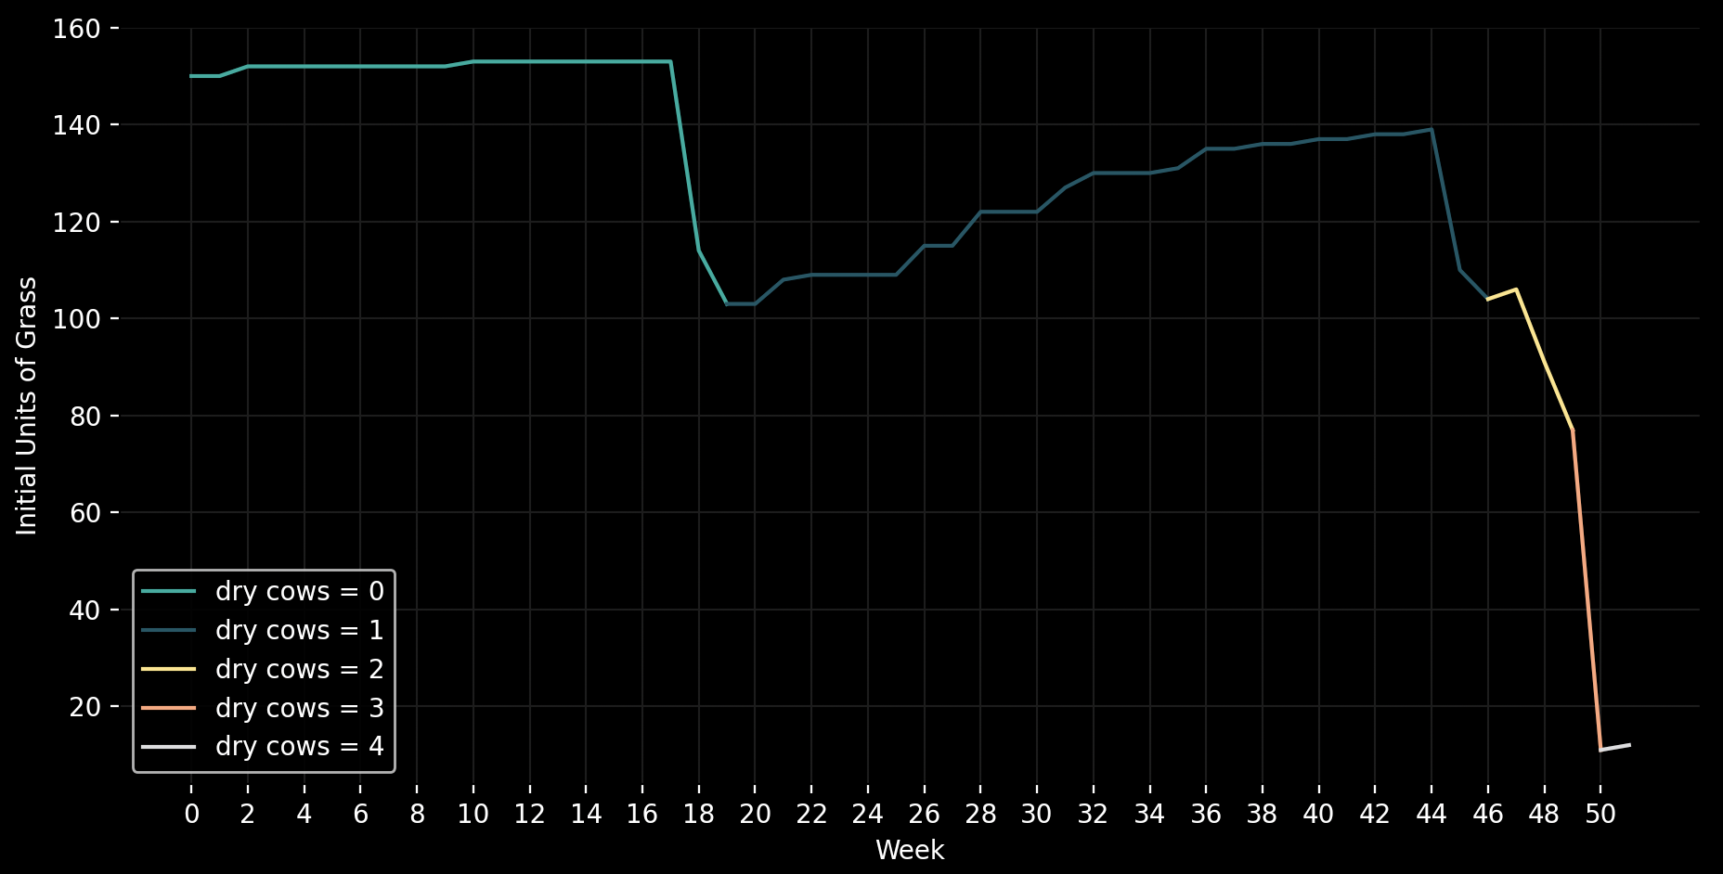
OPTIMAL STRATEGY – INITIAL UNITS OF GRASS FOR MAXIMUM PROFIT
Required Weekly Feed
Notes:
This graph depicts the required initial units of grass in this optimal strategy as well as displaying when cows should be dried. To achieve a maximal profit, Teal Cow Dairy should aim to follow this strategy as closely as possible.

Slide 37
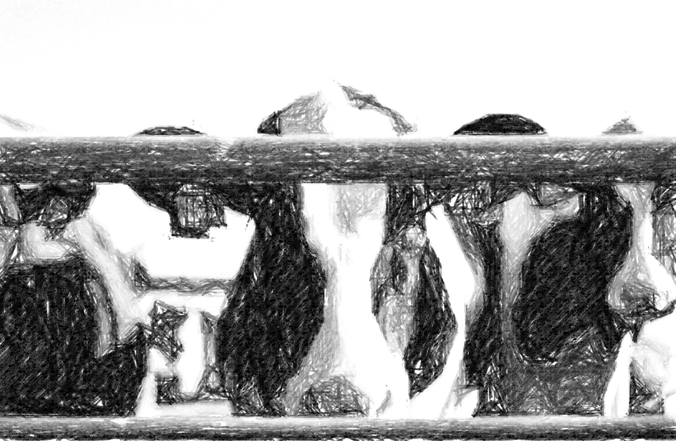
PRODUCT - Interactive Strategist
Notes:
To make the model more accessible, as well as offer guidance even when plans deviate slightly.
we have made available an interactive model which takes the current situation and determines the best next steps in an optimal strategy.

Slide 38
THANK YOU
Notes:
Thank you for your time and please reach out if you require any further clarification on any of the points raised.

